Slide 1
NEW PARENT ORIENTATION

Slide 2
NEW PARENT ORIENTATION
Information Distribution
Coach Keller’s E-mail is the best source
Team Website – still working through kinks - https://www.fasttigers.com/newparents
Reaching out to Coaches
Reaching out to the Board (wolfts10@hotmail.com)

Slide 3
NEW PARENT ORIENTATION
Swimming Season
Offered 52 weeks a year
Short Course Yards Season (SCY): September – March
Long Course Meter Season (LCM): April – August
Meets
FAST Fridays – Intersquad Meets – Mostly “monthly” throughout the year
Monster Splash – October (Event Support)
Travel Meet – Early November (HS Season)
Santa Claus Invitation – December (Event Support)
Mudsock Invitational – January (Event Support)
Travel Meet – February
Championship Season – March (Event Support – Even Years)
FAST 500 (LCM) – May (Event Support)
Summer Jam (LCM) – June (Event Support)
Travel Meet (LCM) (Noblesville) – July
Championship Season (LCM) – July/August

Slide 4
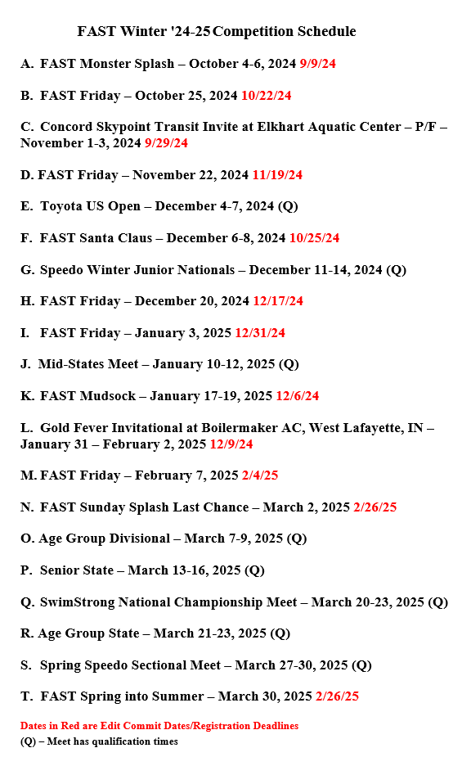
NEW PARENT ORIENTATION
Meets

Slide 5
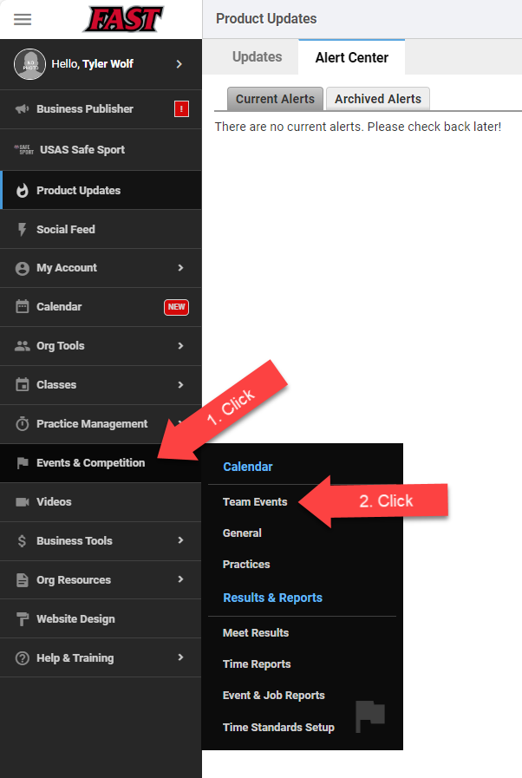
NEW PARENT ORIENTATION
Team Unify - Meets

Slide 6
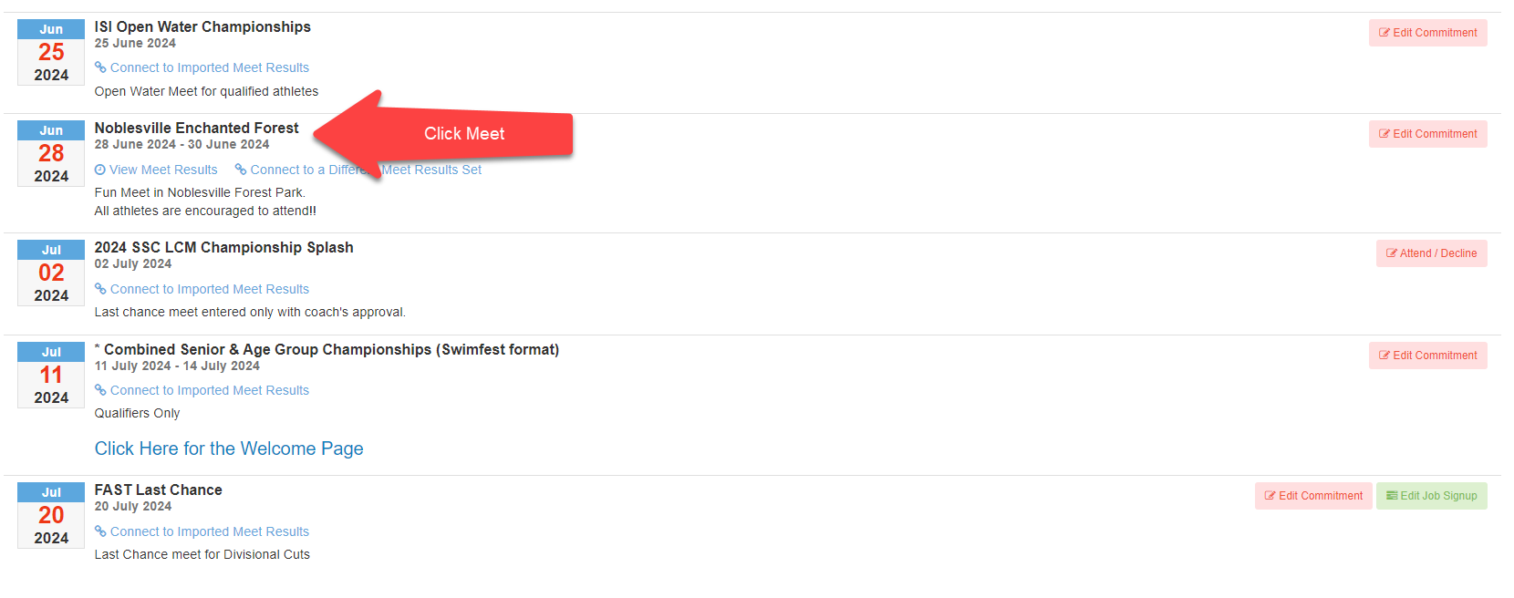
NEW PARENT ORIENTATION
Team Unify - Meets
Meet Letter

Slide 7
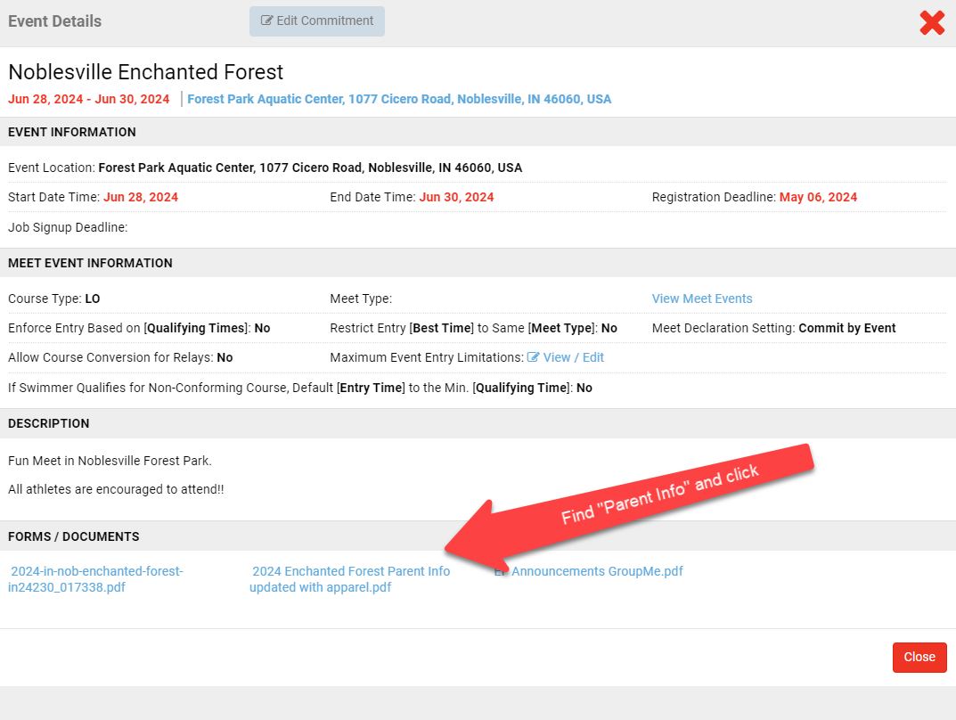
NEW PARENT ORIENTATION
Team Unify - Meets
Meet Letter

Slide 8
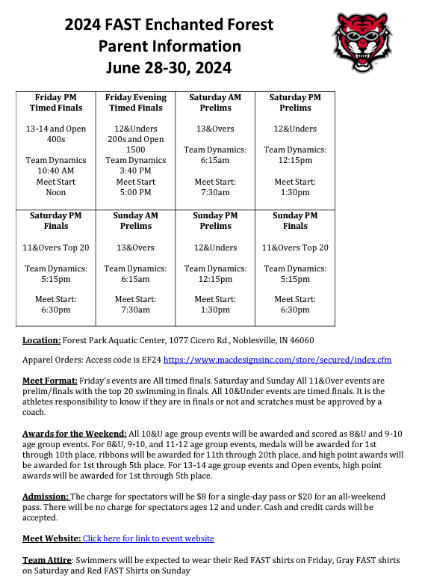
NEW PARENT ORIENTATION
Team Unify - Meets
Meet Letter
My girls like to get dropped off 15 minutes prior to Dynamics

Slide 9
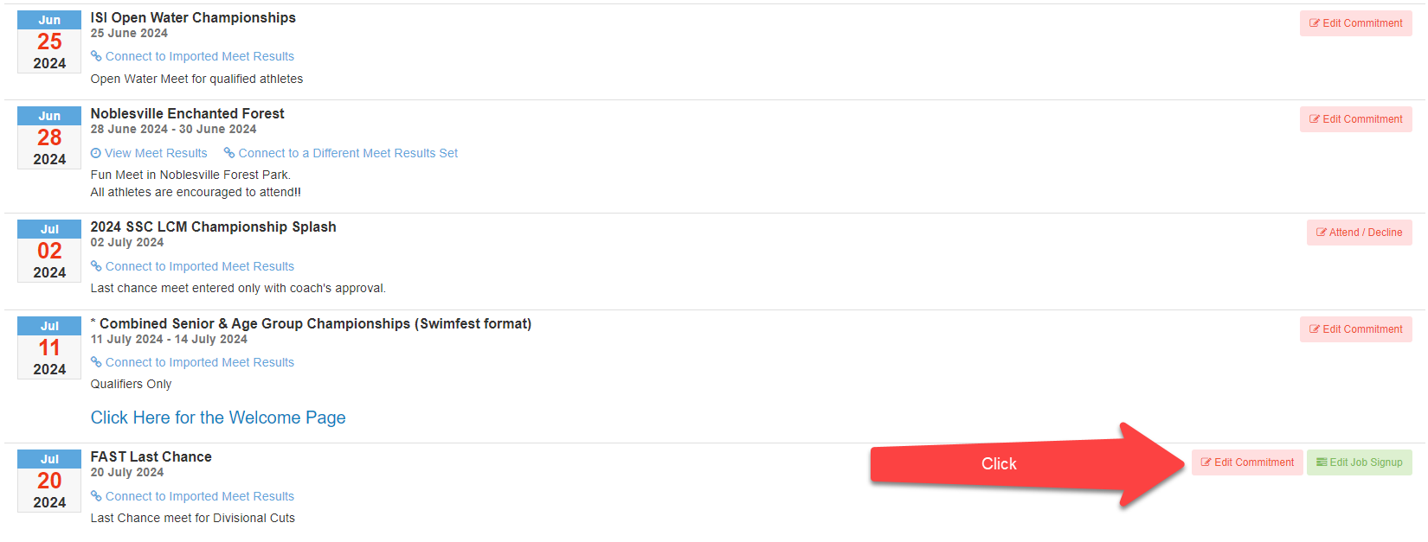
NEW PARENT ORIENTATION
Team Unify - Meets
Swimmer Commitment

Slide 10
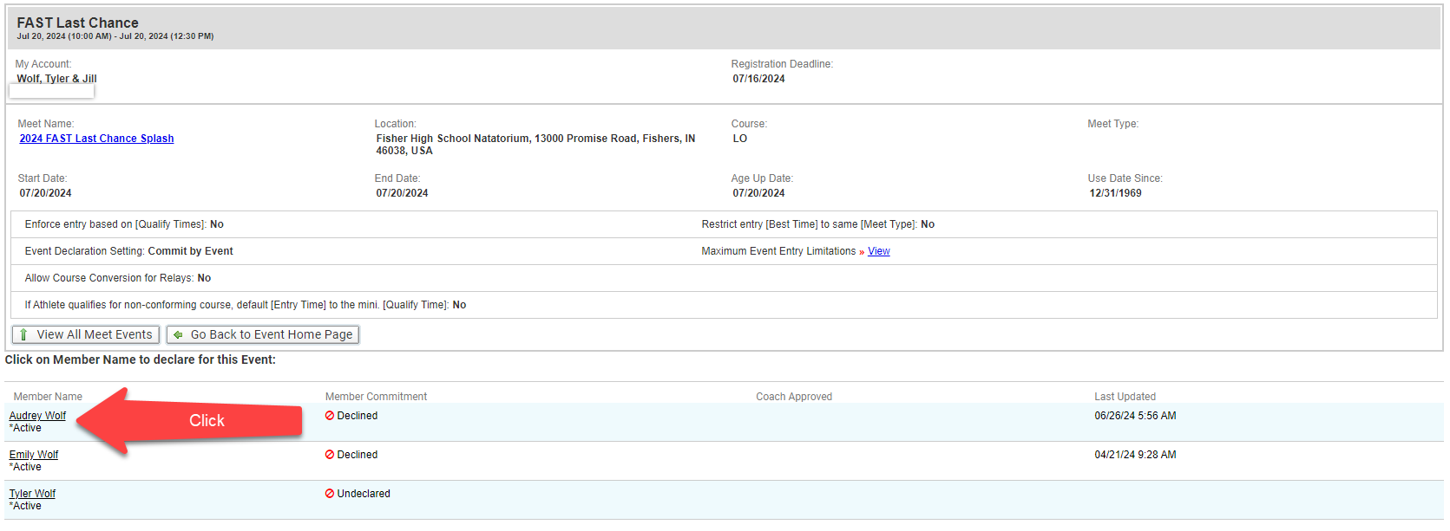
NEW PARENT ORIENTATION
Team Unify - Meets
Swimmer Commitment

Slide 11
NEW PARENT ORIENTATION
Team Unify - Meets
Swimmer Commitment – Before you can choose events

Slide 12
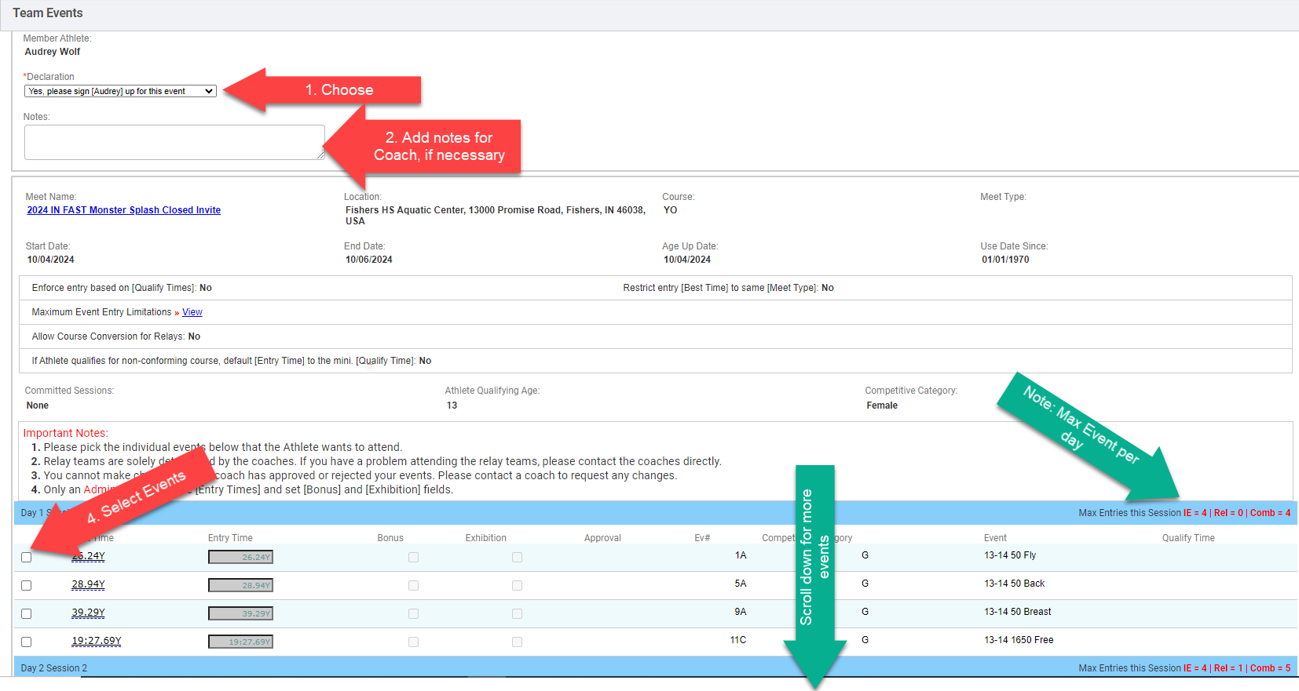
NEW PARENT ORIENTATION
Team Unify - Meets
Swimmer Commitment – While you can choose events
Prelim./Final Session – max 3 events per day
Timed Finals – max 6 per day. Often limited to 4 or 5

Slide 13
NEW PARENT ORIENTATION
Team Unify - Meets
Event Support
TC1, TC2 & TC3 – 2/3 shifts per Event Support Meet
All other Groups – 2/4 shifts per Event Support Meet
If multiple swimmers – larger of two groups
Unavailable to Work- $25/session for 3 sessions, then $50/session for 3 sessions and then $75. All based on “per season”.
$75/session if “No Show” or not signed up
Fast Fridays are on “Volunteer” basis
We always need help!

Slide 14
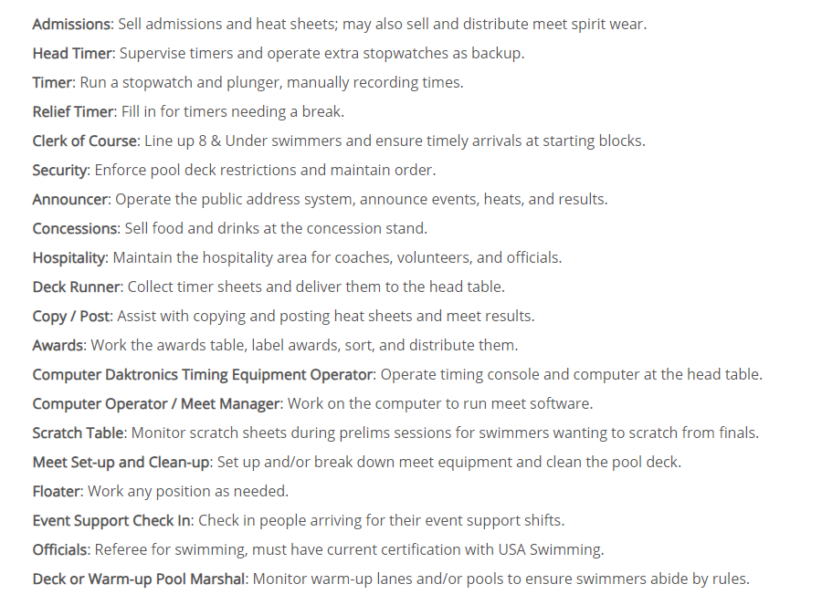
NEW PARENT ORIENTATION
Team Unify - Meets
Event Support
Good Beginner spots
Always need Help

Slide 15
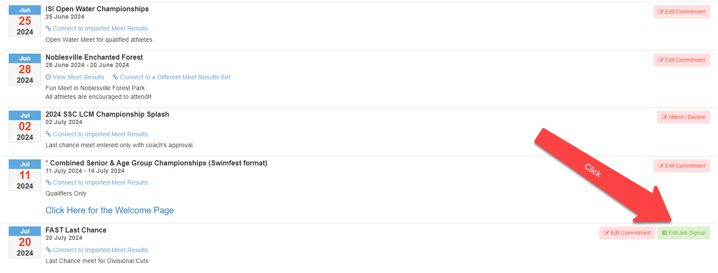
NEW PARENT ORIENTATION
Team Unify - Meets
Event Support

Slide 16
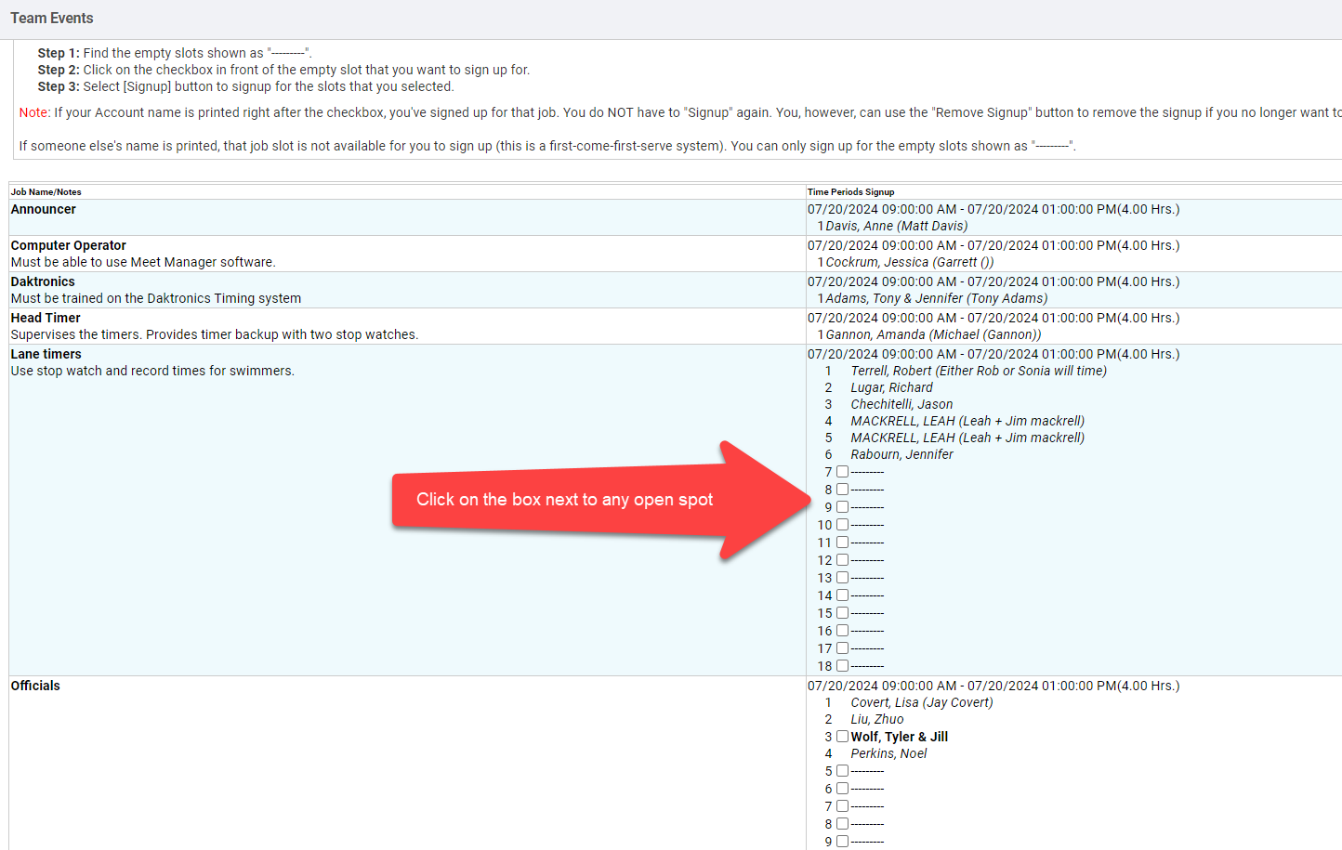
NEW PARENT ORIENTATION
Team Unify - Meets
Event Support

Slide 17
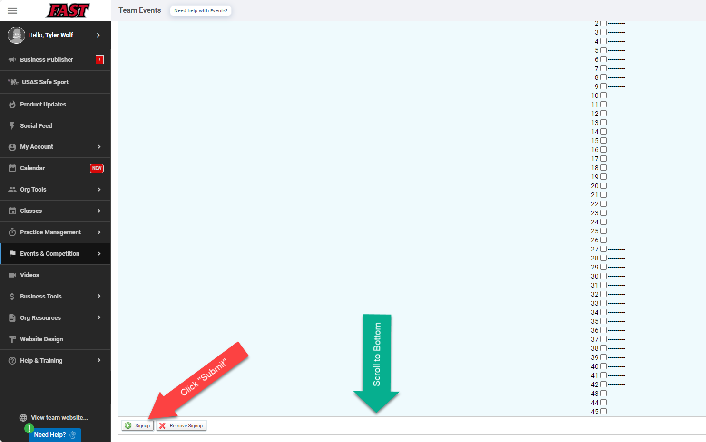
NEW PARENT ORIENTATION
Team Unify - Meets
Event Support

Slide 18
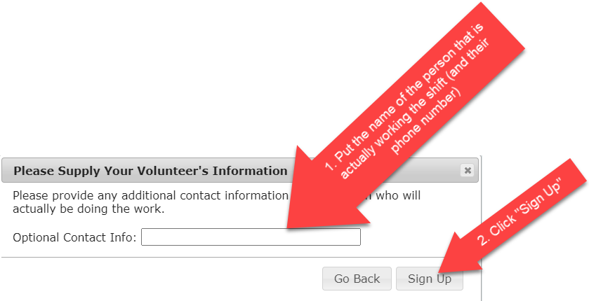
NEW PARENT ORIENTATION
Team Unify - Meets
Event Support
It doesn’t just have to be parents. Family, Friends, Siblings (14+)…

Slide 19
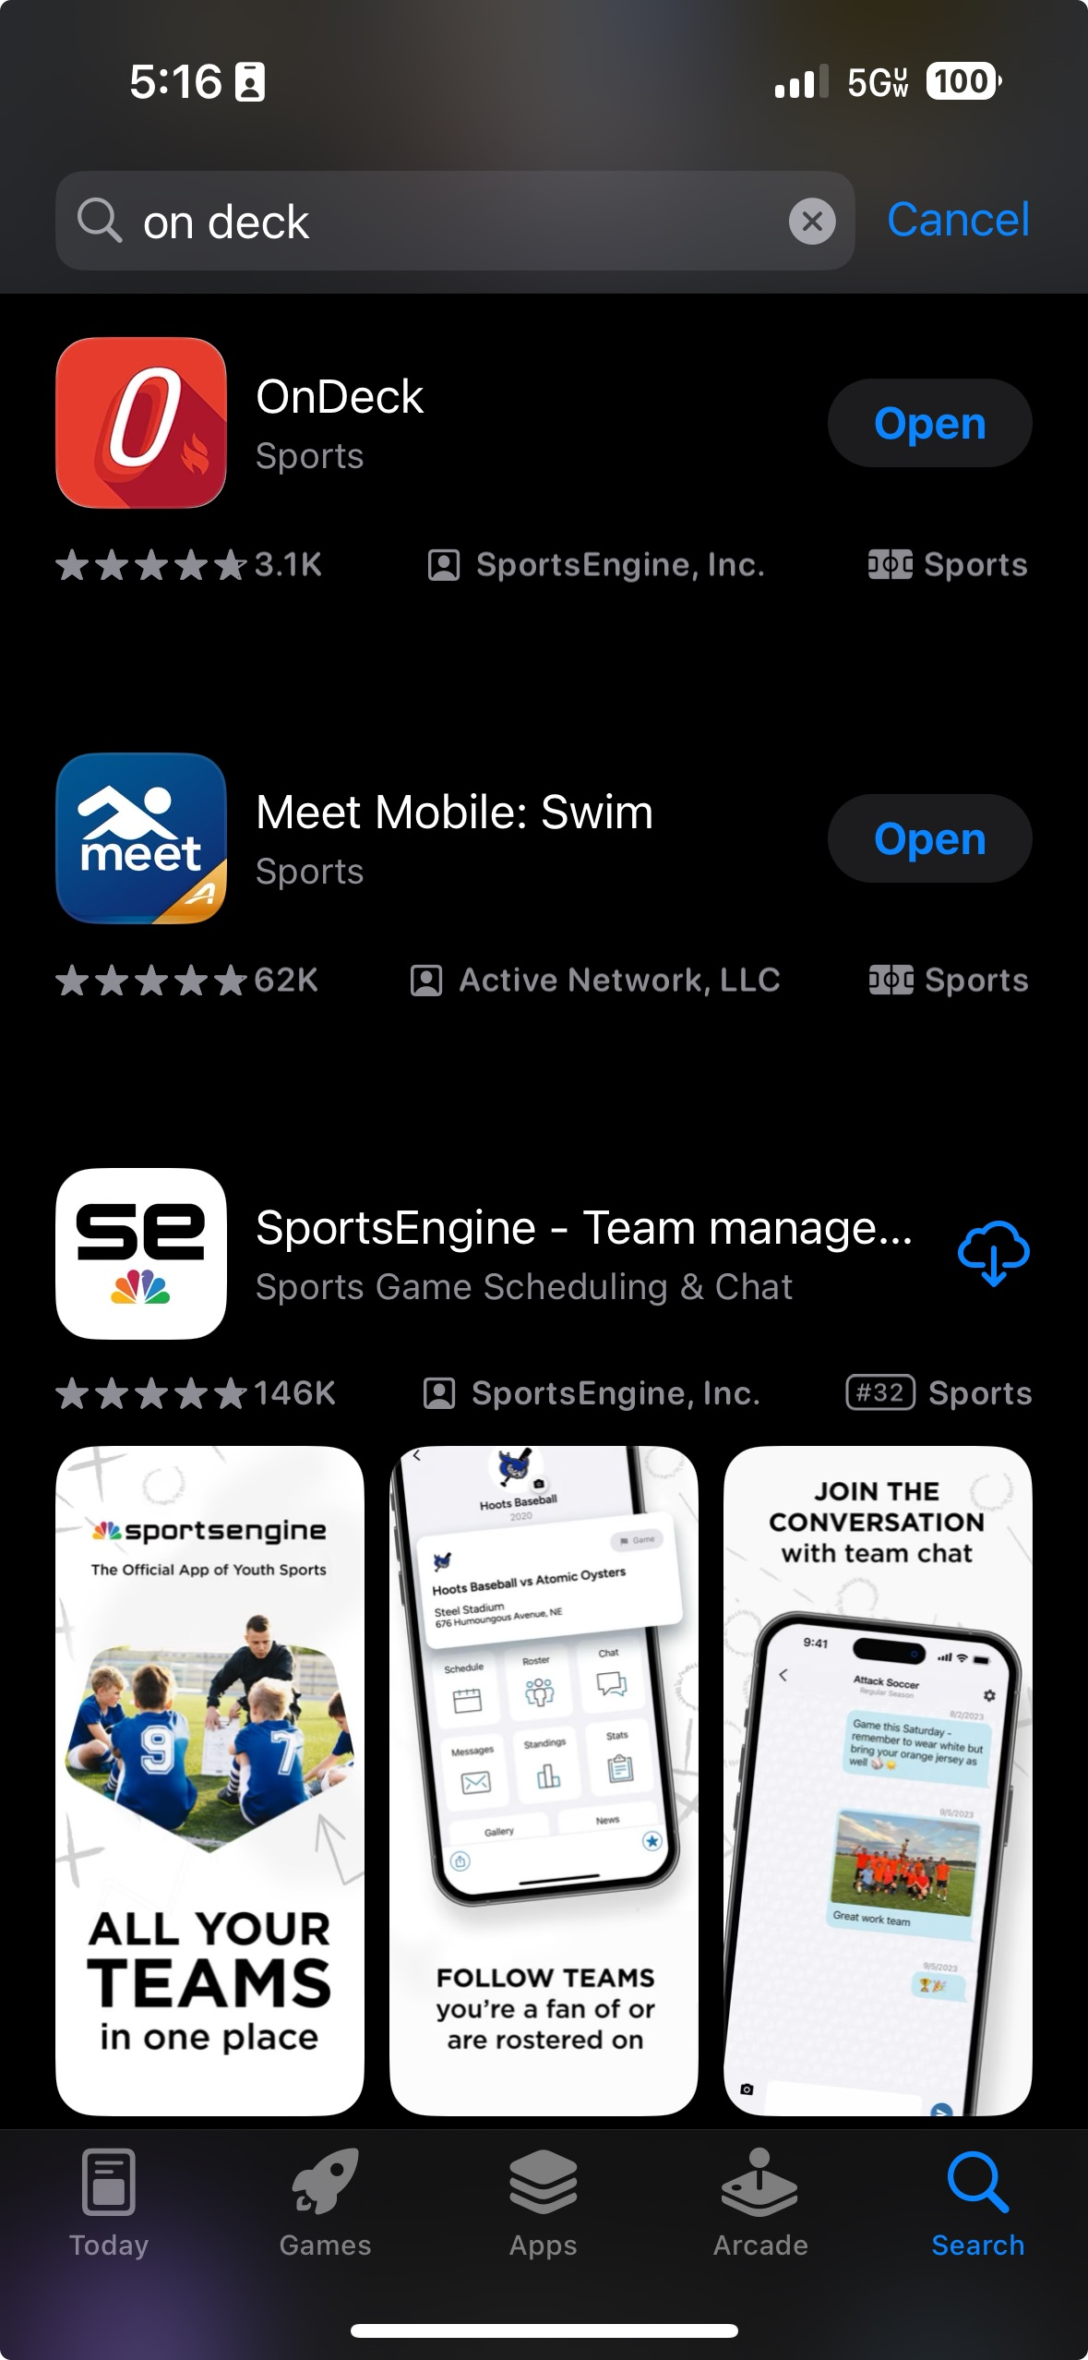
NEW PARENT ORIENTATION
On Deck - Meets
Download the “OnDeck” App

Slide 20
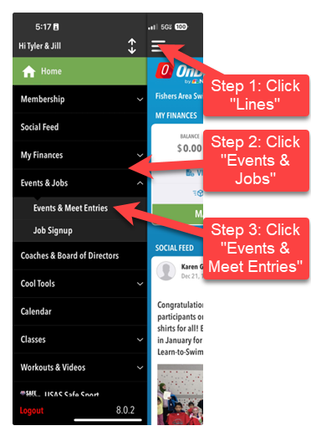
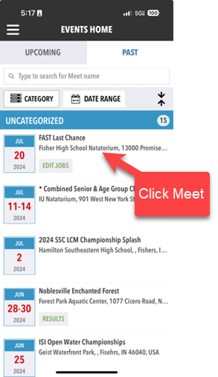
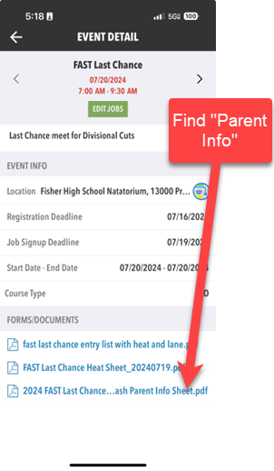
NEW PARENT ORIENTATION
On Deck - Meets
Meet Letter

Slide 21
NEW PARENT ORIENTATION
On Deck - Meets
Swimmer Commitment

Slide 22
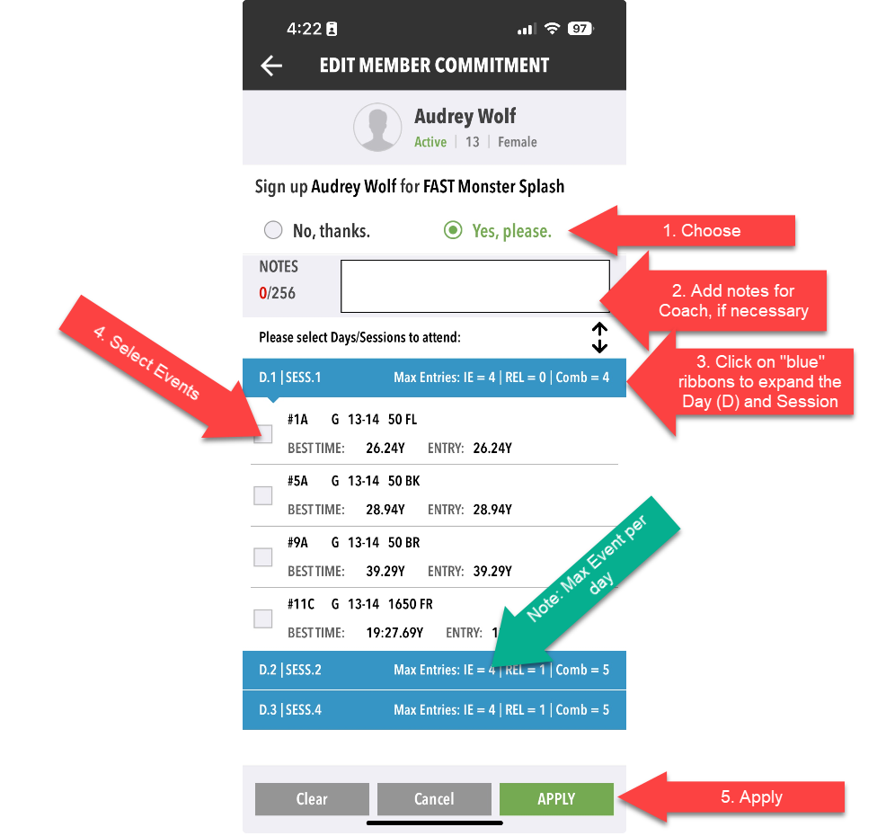
NEW PARENT ORIENTATION
On Deck - Meets
Swimmer Commitment

Slide 23
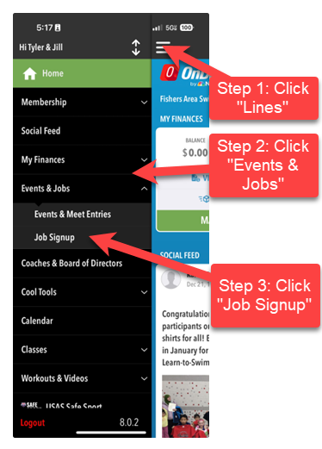
NEW PARENT ORIENTATION
On Deck - Meets
Event Support

Slide 24
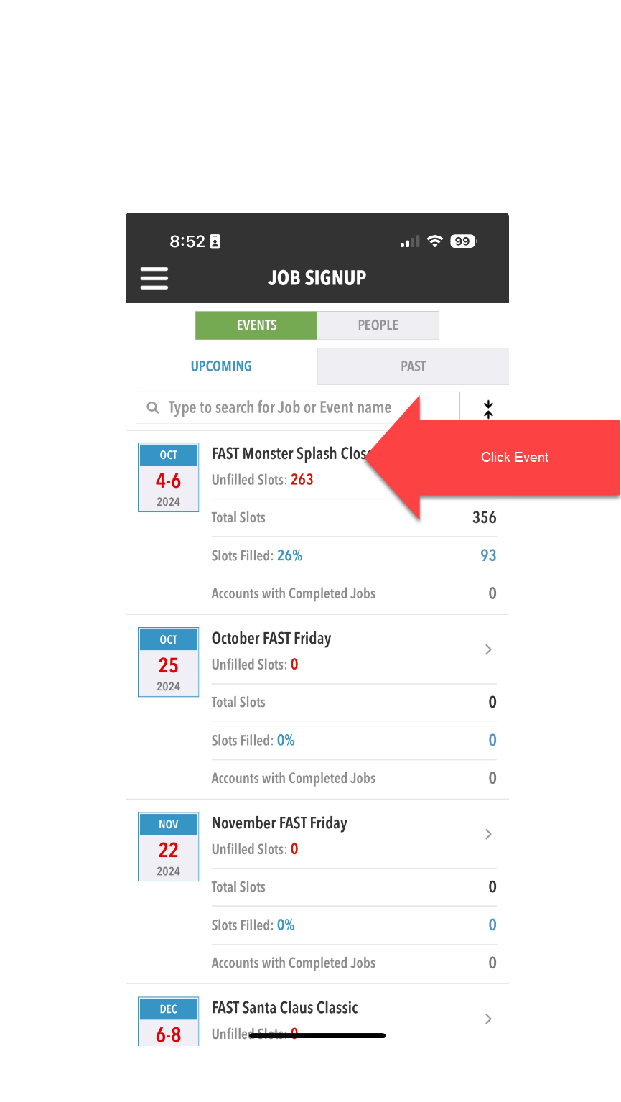
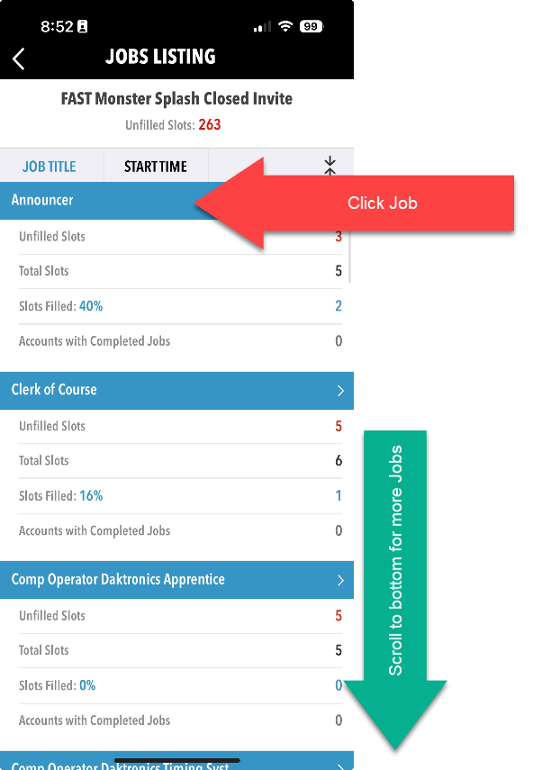
NEW PARENT ORIENTATION
On Deck - Meets
Event Support

Slide 25
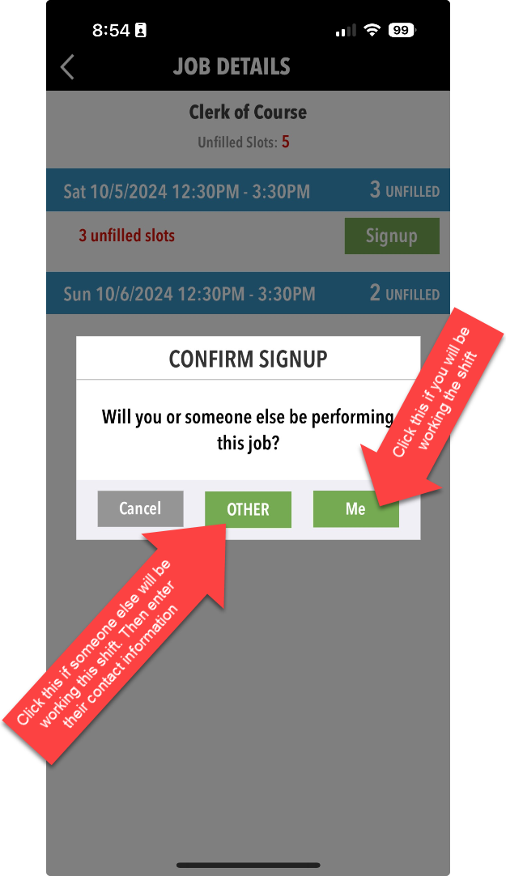
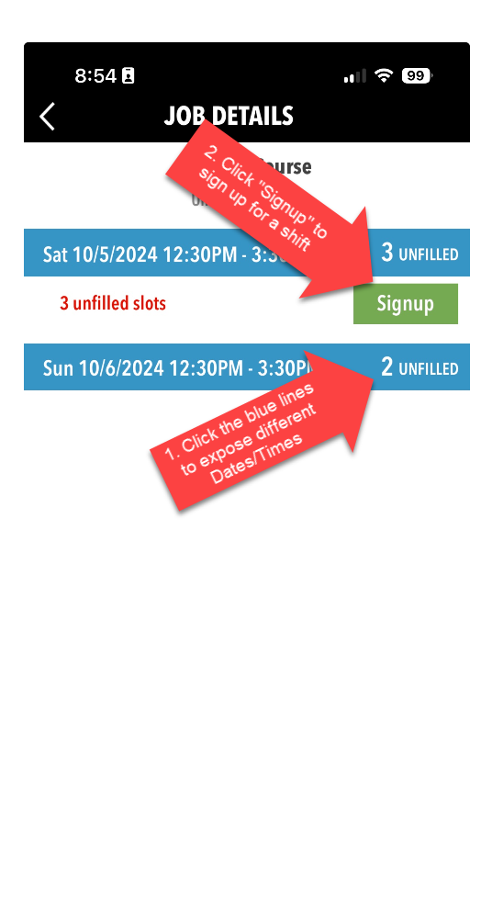
NEW PARENT ORIENTATION
On Deck - Meets
Event Support

Slide 26
NEW PARENT ORIENTATION
Meet Mobile
Your best friend at a swim meet
I recommend the paid subscription, but don’t remember the limitations for the free subscription
This is where you will see the results
Favorite your swimmers or their friends
Favorite Fishers Area Swimming Tigers
So much information on Meet Mobile. This will just be the basics.

Slide 27
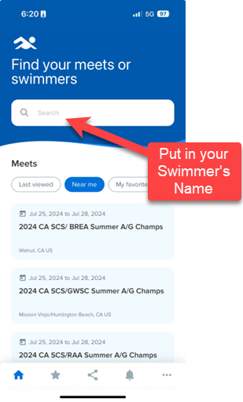
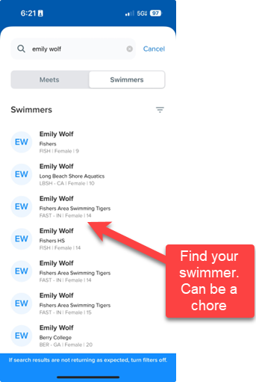
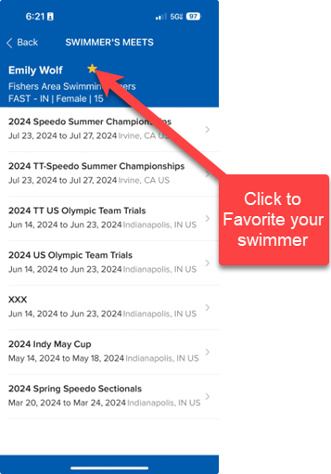
NEW PARENT ORIENTATION
Meet Mobile
Find your Swimmer

Slide 28
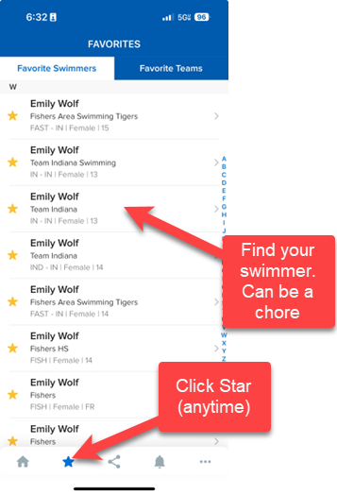
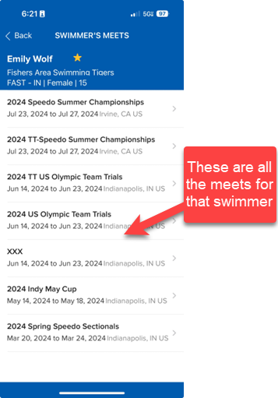
NEW PARENT ORIENTATION
Meet Mobile
Find your Swimmer

Slide 29
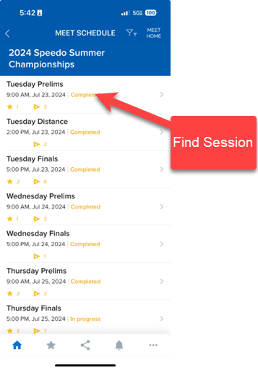
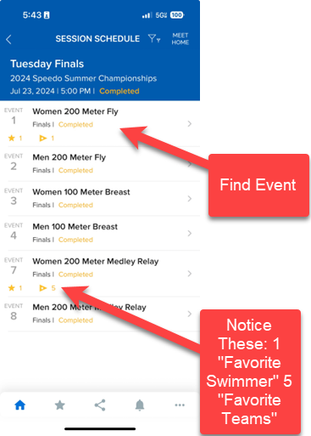
NEW PARENT ORIENTATION
Meet Mobile
Meets

Slide 30
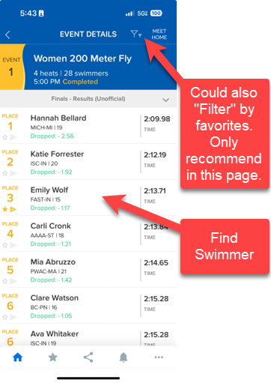
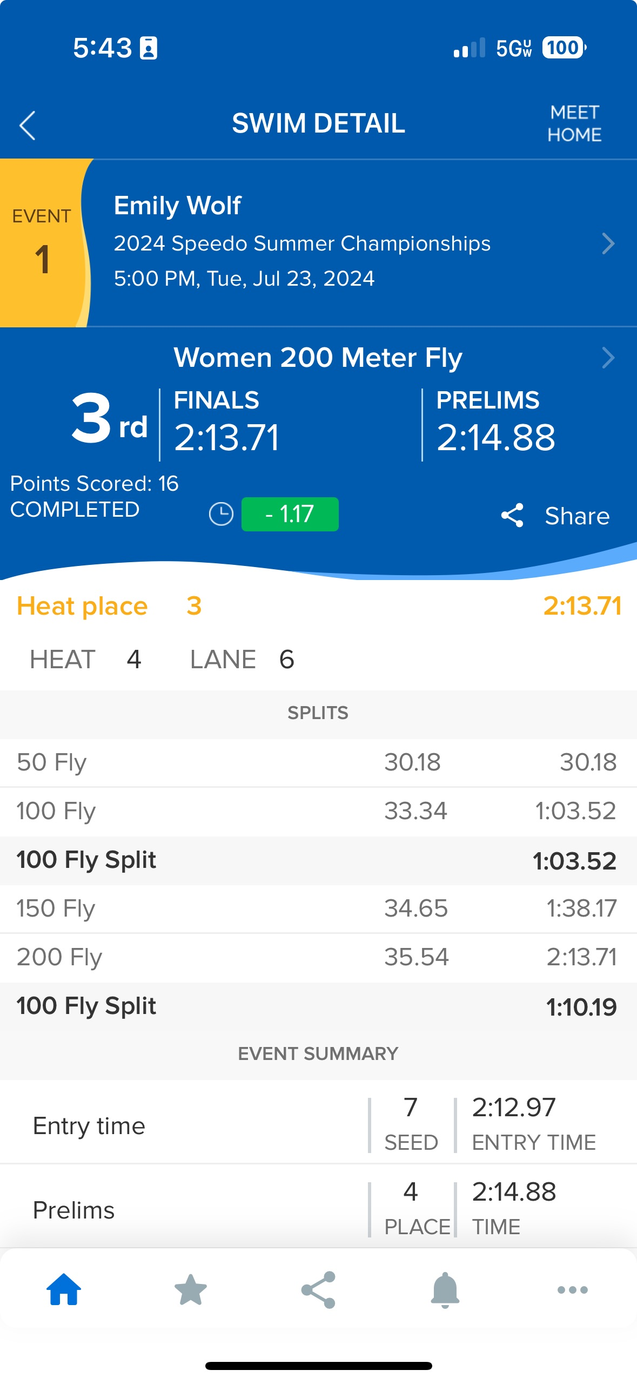
NEW PARENT ORIENTATION
Meet Mobile
Meets

Slide 31
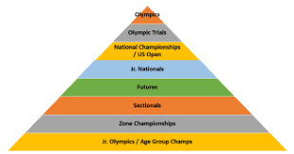
NEW PARENT ORIENTATION
Championship Meets
Will cover the bottom two levels of the pyramid – Age Group
Club Championship
SCY Divisionals Early March
FHS every other year
SCY State Championship – Following Weekend
At IUPUI Natatorium
Team Pasta Dinner
Secret Psycher
Championship Team Shirt

Slide 32
NEW PARENT ORIENTATION
Championship Meets
Will cover the bottom two levels of the pyramid – Age Group
Club Championship
LCM State Championship – Mid/Late July
At IUPUI Natatorium
LCM Divisionals
At Crawfordsville/Franklin
Not intuitive
Week or so after State
Swam in SCY
Team Pasta Dinner
Championship Team Shirt

Slide 33
NEW PARENT ORIENTATION
Championship Meets
Team Indiana Championships
Mid-States – Early January – Invitation Only – APPLY!!!
At IUPUI Natatorium
Team Indiana picks swimmer events to win
Zones
Elkhart, IN
Fargo, ND
Minneapolis, MN
Holland, MI
Etc.

Slide 34
NEW PARENT ORIENTATION
Time Standards
Fasttigers.com – Bottom of Page

Slide 35
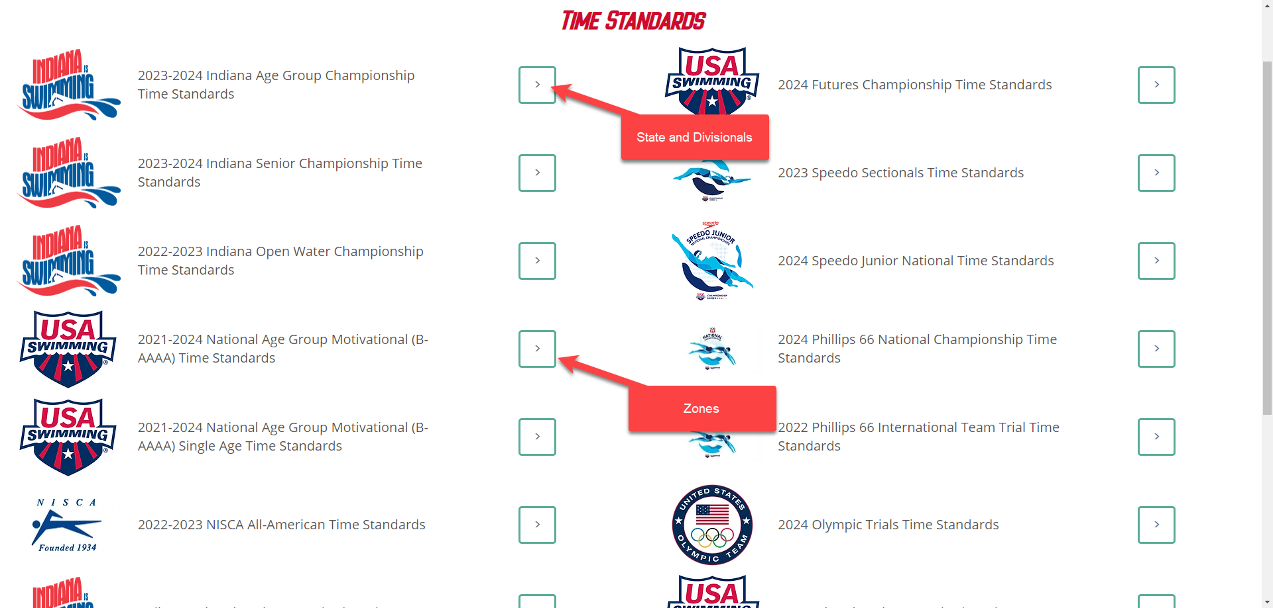
NEW PARENT ORIENTATION
Time Standards

Slide 36
NEW PARENT ORIENTATION
Time Standards
State and Divisionals
Find your Age → Find your Event → Find your Course (SCY, LCM..)
SCY times qualify you for LCM Championship Meets
“Age-ups” can be rough. Stay positive

Slide 37
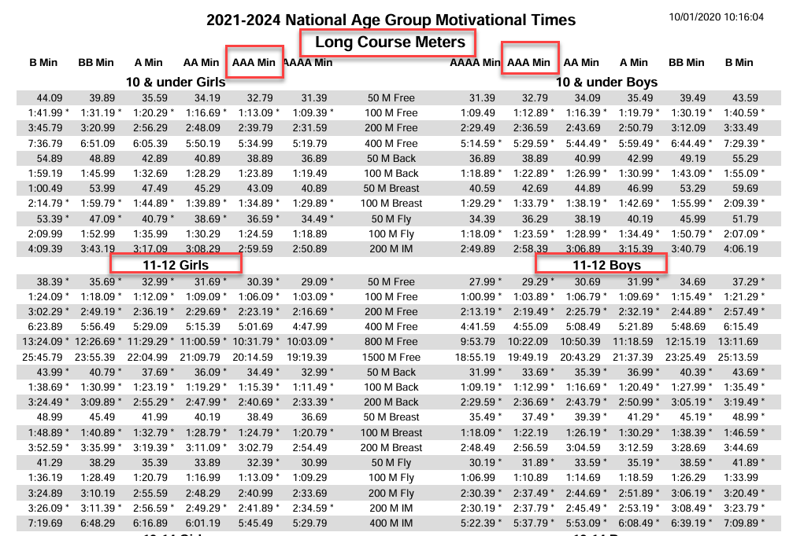
NEW PARENT ORIENTATION
Time Standards
Zones
Find your Course → Find your Age → Find your Event
AAA Times
Will get an e-mail in May/June to apply, but can apply all the way through LCM State
Swimmers pick Events
Can swim 3+ Events

Slide 38
NEW PARENT ORIENTATION
IMX Scores
Numerical Way to evaluate overall swimmer
FAST uses it as one way to assign groups
Need to swim each event at least once a season to get a score
At higher levels, can be used to get invitations to camps
Fasttigers.com – Bottom of Page
Not the “End all Be All” – Don’t sweat it

Slide 39
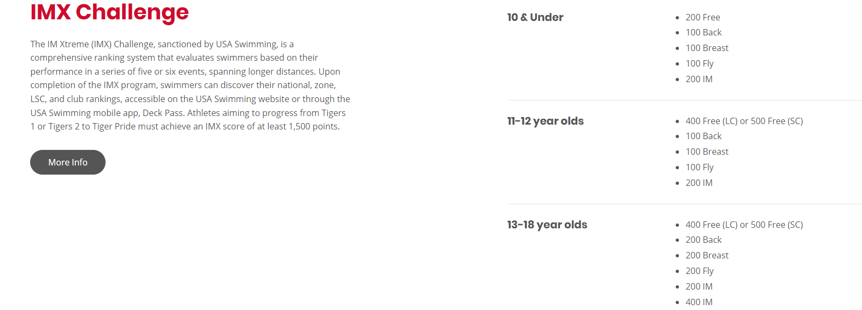
NEW PARENT ORIENTATION
IMX Scores

Slide 40
NEW PARENT ORIENTATION
Spiritwear - Swimmers
FAST issues red, gray, and black shirt
FAST issues 1 silicone and 1 latex cap
Spiritwear – Parents
FAST issues 1 red shirt per parent/guardian
Elsmore sells “alternative” spiritwear
Opportunities to buy “Championship Shirts” in spring

Slide 41
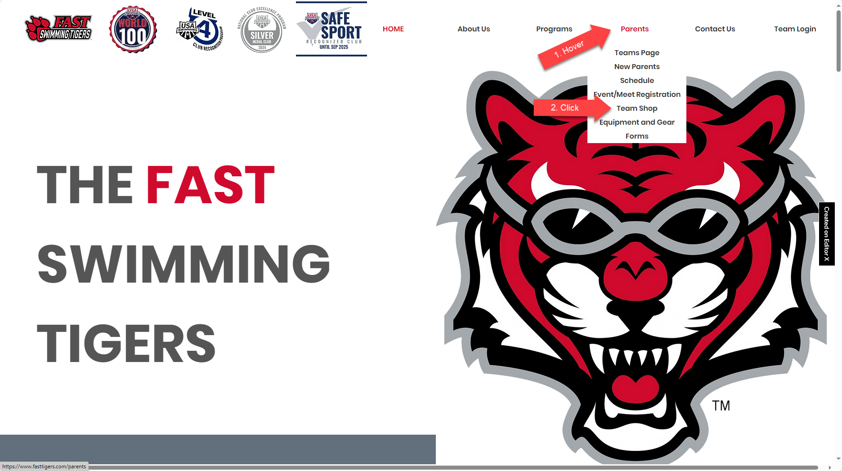
NEW PARENT ORIENTATION
Spiritwear – Parents
Elsmore Shop

Slide 42
NEW PARENT ORIENTATION
QUESTIONS?

