Slide 1
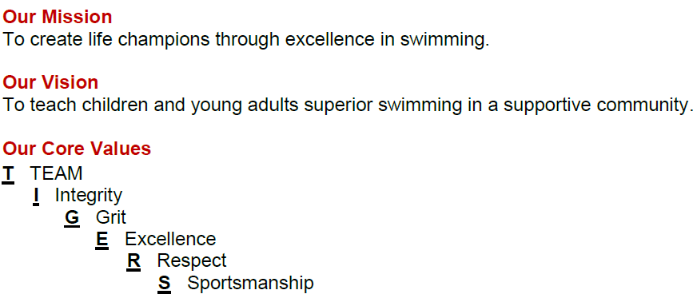
2024/2025 Updates
Quick Hits
Entering our 19th year
501(c)(3)
– “…foster Amateur sports program”
Small business
Governed by Parents / Directed by Head Coach
Wet Side (Coaches)
Athlete Development
Training Components
Competition Management
Dry Side (Head Coach / Board of Directors)
Financial Management
Day to Day Business Operations
Team/Event Support

Slide 2
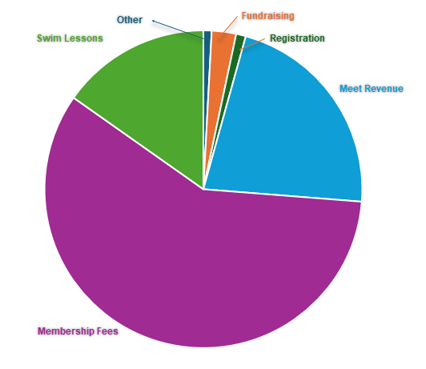
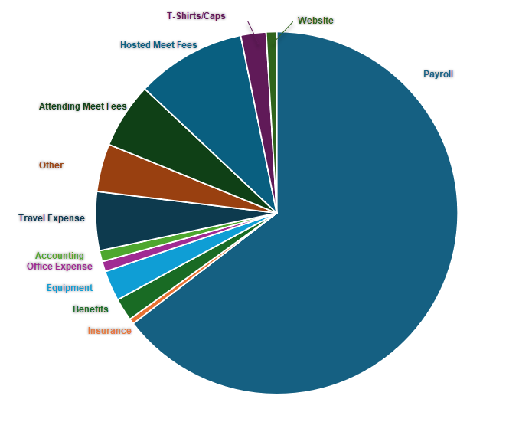
2023/2024 Review
INCOME
EXPENSES

Slide 3
2024-25 Budget Summary
INCOME
EXPENSES
Member Dues – 64%
Meet Income – 18%
Lessons Income – 10%
Other – 8%
Payroll (includes lessons, taxes) – 66%
Meet Expenses – 14%
Travel – 6%
T-Shirts Caps – 2%
Operations – 12%

Slide 4
FAST Families Drive Success
Hosted Meets
Lower Cost to Families
Athlete Commitment
World Class Swim Club
Meet Support
Meet Support Critical to Hosting Meets
Hosting Meets = Lower Member Dues
Lower Member Dues = Savings to FAST Families
Savings for Families = Ability to stay Committed
Commitment = World Class Swim Club

Slide 5
FAST Family Event Support Requirements
FAST is known for hosting high-quality competitions. Teams travel to our popular FAST-hosted meets from all over the Midwest. The biggest benefit of hosting these meets is they provide our athletes with high-quality competition, while reducing the training dues paid by FAST families and minimizing travel expenses for our families.
Families must provide event support regardless of whether or not their swimmer(s) are participating in the FAST-hosted meet.
Event Support can be performed by Parents, Siblings (depending on age/shift), Grandparents, Neighbors, Friends…

Slide 6
FAST Family Event Support Requirements
Event Support Requirements
Historically, TC1, TC2 & TC3 (Tiger Cubs) required 2 Event Support Sessions. All other training groups required 3 Event Support Sessions.
This year:
Monster Splash – All training groups 2 Sessions
Santa Claus Classic – Tiger Cubs 3 Sessions, all other training groups 4 Sessions
Mudsock Meet – Tiger Cubs 3 Sessions, all other training groups 4 Sessions
FAST 500 – All training groups 2 Sessions
Summer Jam - Tiger Cubs 3 Sessions, all other training groups 4 Sessions
Last year had more meets, Tiger Cubs worked 12-14 shifts and rest worked 18-21 shifts. This year Tiger Cubs will work 13 shifts and rest will work 16 shifts.
Needed more support at the larger meets
Needed 579 shifts at last year Mudsock and 383 shifts were worked. 20 Families worked an extra 42 shifts.
Will evaluate at each meet

Slide 7
FAST Family Event Support Requirements
Prior to each meet, our Event Support Coordinator will send an email to announce that the sign up is open. Please prioritize these emails, as they will provide details about the meet, as well as the support specifics. If there is a change in the Event Support Requirement, the Event Support Coordinator will notify team families.
Families are strongly encouraged to work the sessions. If a family does choose to “Unavailable to Work" for a meet before the sign-up window closes, a $25 per session fee will be charged to their account. After 3 “Unavailable to Work” per year (September - August), the cost increases to $50 per session. After 6 Unavailables per year, the cost increases to $75 per session.
Those who do not sign up, mark “Unavailable to Work”, or show up for their event support shifts are automatically assessed a financial penalty of $75 per session. This ensures that FAST can provide adequate staffing at our hosted meets, achieve our budget goals, and keep families' dues low.
If the athlete is participating in a higher-level event, such as TYR Pro or Winter Nationals, that conflicts with a FAST-hosted meet, the “Unavailable to Work" fee will be waived for the family. If the athlete ends up swimming in part, but not all, of the FAST-hosted meet, the event support obligation will be in force.

Slide 8
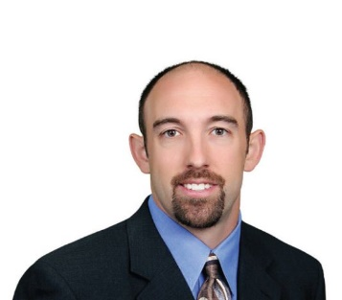
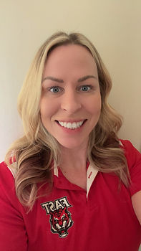
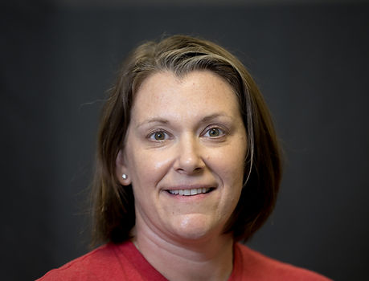
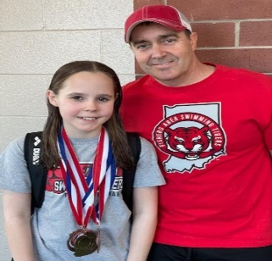
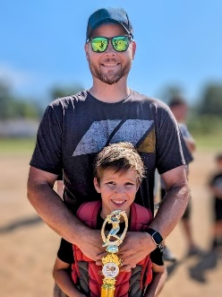
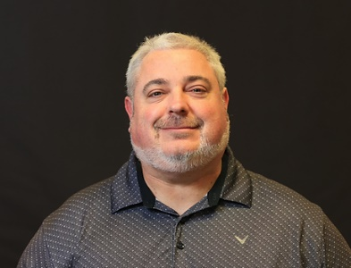
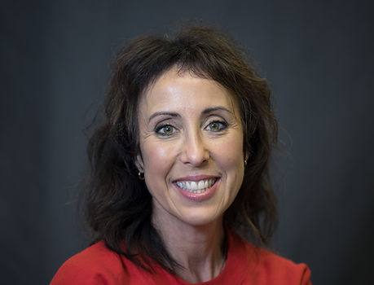
2024/2025 Board Elections
2 Positions are up for Election
Current / Remaining Members
Term expiring 2024
Term expiring 2025
Term expiring 2026
Tyler
Wolf
Stacey
Harvey
Noel
Perkins
National & Tigers Pride training groups
Elite & Tigers Pride training groups
Michael
Schumacher
Garrett
Cockrum
Matt
Davis
Tiger Pride & Tiger Stripes
National training group
Tigers 3 & Tiger Cubs 2
Heather Lee
SafeSport Coordinator
Tiger Pride and Elite training groups

Slide 9
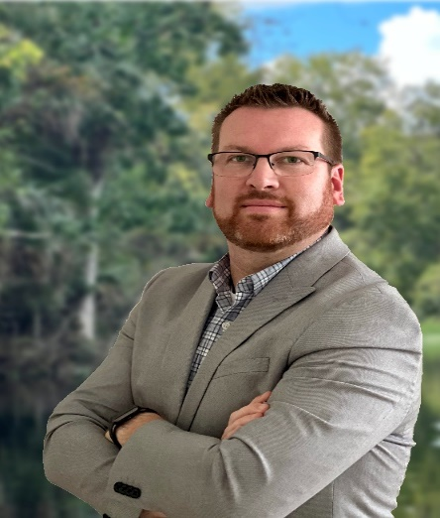
2024/2025 Board Elections
2 Positions Are Open – term expires 2027
Candidates for Open Seats
Tyler Wolf
Matt Riley
National & Tigers Pride training groups
Tigers 3 training group

Slide 10
FAST Swim-A-Thon 2024
Kick-off - September
Event – October 24, 2024
Celebration – TBD – Post Event!
Goal: Raise $30,000
Purpose:
1. To Provide a Fun and Challenging Competitive Experience for ALL FAST Tigers
2. To Generate Funds to Support FAST Programming and Equipment needs along with Future Expansion
*Divisional Meet!
Promotion:
1. Roll-out Dates & Deadlines
2. Social Media & Personal Promotional Page
Incentives:
1. Individual, Group, TEAM Celebration
2. Prizes!!!

Slide 11
FAST: Proud of the Past, Excited for the Future!
While the past is apparent upon reflection, it is what we learn and how we respond that makes it valuable for the future. To this point, how do we process, demonstrate progress and thrive? As we always do…FAST plans for success. Strategically, we plan to overcome challenges and obstacles to succeed. How? We…
1. Identify Challenges
2. Seek Innovative Solutions
3. Grow through Opportunity
Respecting the past and navigating the future, with respect, will allow us to prevail, thrive and succeed!
Coach Keller's Top 3 takeaways from 2023...
Communicate, Communicate, Communicate
Determine a Goal that is Worth Achieving
Engage with Flexibility, Adaptability and a Think Out of the Box Mentality
Forward thinking...
*Gold Medal Club – 2024!
*Club Development – Building People, Building Champions!

Slide 12
FAST: A Quest for Excellence!
While the past is apparent upon reflection, it is what we learn and how we respond that makes it valuable for the future. To this point, how do we process, demonstrate progress and thrive? As we always do…FAST plans for success. Strategically, we will Aim for Excellence. How? We WILL…
1. Continually Prepare
2. Give Championship Efforts
3. Make Consistency Normal
Respecting the past and navigating the future, with respect, will allow us to achieve, thrive and succeed!
Coach Keller's Top 5 takeaways from 2024...
Create and Prepare…Opportunity!
Even at Your Best…It Takes More!
Good to Great is Marginal!
Never, Ever Give UP!
We are Capable…BELIEVE!
Forward thinking...
*Podium Club – Gold Medal x 4!
*Olympic “Performance”
*Club Development – Building People, Building Champions!

Slide 13
FAST Program of Excellence
FAST Programming
FAST is a FULL Service Aquatics Club
Learn to Swim Program
Pre-Team
Competitive Team
HS/College Programs – HS Prep, CAPP
Adult Swim Program
FAST Diving Tigers
FAST Competitive Team Structure
The FAST competitive program has five Divisions:
FUNdamentals, Learn to Practice, Learn to Train, Train to Compete, and Compete to Excel.
Four Training Groups within 10&Under / 11-14 / Senior Age Groups *Emerging Elite!
Training Groups and Standards of Achievement.
FAST Staff…

Slide 14
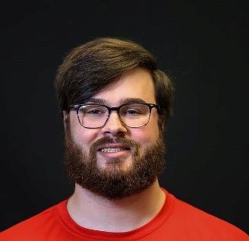
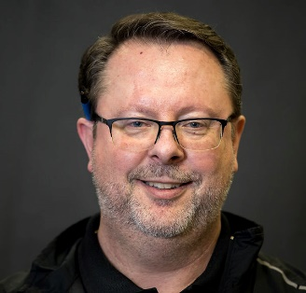
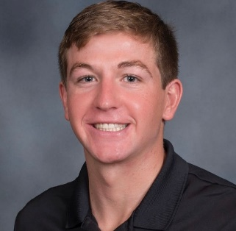
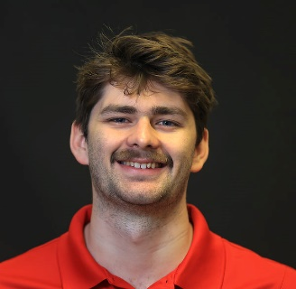
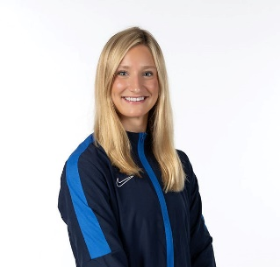
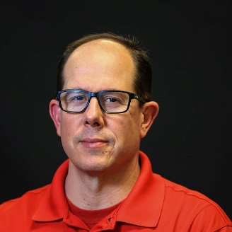
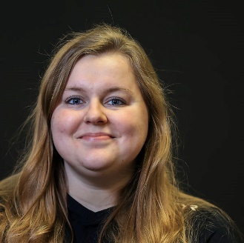
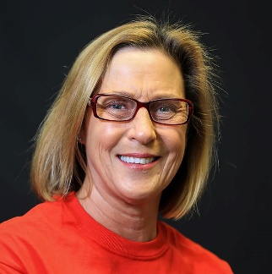
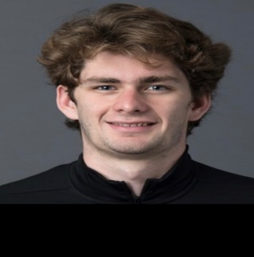
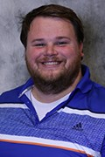
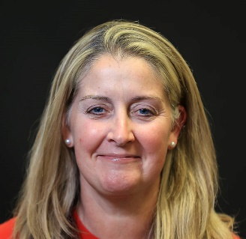
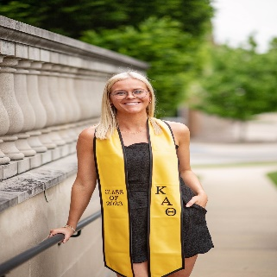
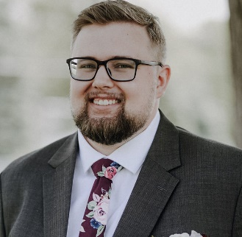
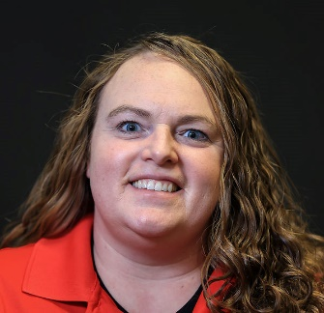
2024/2025 Coaching Staff
Joe Keller
Head Coach/Director/
Co-Business Manager
Kris Keller
Emerging Elite/Tiger Pride/ Website/Social Media
T.C. Smith
Tiger Stripes
Alec Haley
Associate Head Coach/
National/Mentor Coach
Brett Riley
Masters/Adult Swim/ Emerging Elite/Tigers 3
Mya VanderHagen
Tiger Cubs 3
Steve Sanchez
Head AG Coach/Tiger
Pride/Senior/Co-Business
Manager/Registration
Ellen Fero
Tigers 2/Tiger Cubs 2
Tamisa Lush
Tiger Cubs 2
Garland Wilson
Admin. Assistant/CAPP/ Elite/Learn to Swim SAI Instructor/Lessons & Pre-Team Coordinator
Isaiah Huisman
Tigers 1/HS Prep
Cat Sehr
Tiger Cubs 1

Slide 15
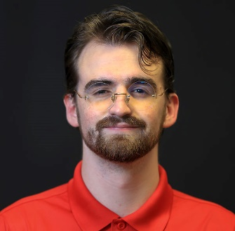
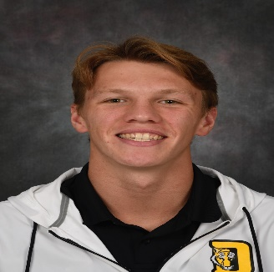
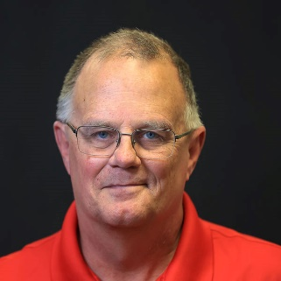
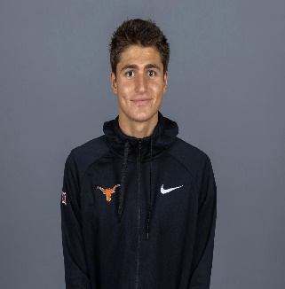
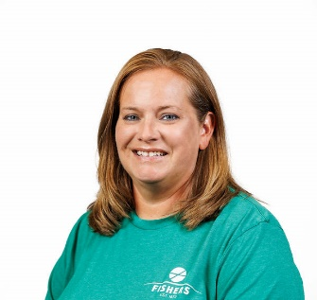
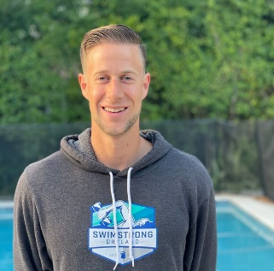
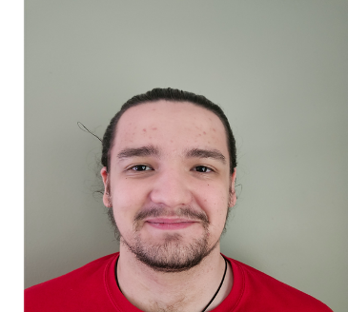
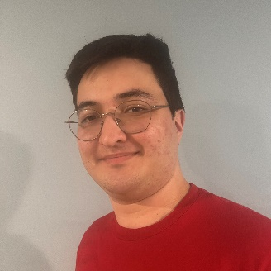
2024/2025 Coaching Staff
Tyler Richmond
Excel
Robbie Sheffield
Tiger Stripes Assistant
Ralph Thielking
Meet Director/ Assistant Coach
Paula Hardin
Pre-Team
Finn Winkler
Tigers 1 Assistant
Eric Hudson
SwimStrong Dryland Founder/Owner
Daniel Pache
Tigers 3/Pre-Team Assistant
Bruno Kitazuka
Tigers Cubs 3&1 Assistant

Slide 16
FAST Program of Excellence
FAST Training Components
Training Time(s) and Amount
Training Space
Long Course Meters
Equipment including Dryland
Technology
Coach to Athlete Ratio
SSDL Program…Training, Leadership, Education and Nutrition & Wellness
FAST Team Culture
TIGERS Values
Leadership & Education
Community…Within FAST & Within Fishers
FAST is the Best Value Full Service Swim Club in Indiana Swimming!

Slide 17
Culture of Performance Excellence
Virtual Club Championship (VCC)
IMX/IMR Program
Club Excellence Program – Gold
Club Recognition Program - Level 4
*Business & Organizational Success
*Parent/Volunteer Development
*Coach Development & Education
*Athlete Development & Performance
5. ISI/USA Camps
6. State/National/International Level Events/Teams
7. Vision
2028 Los Angeles – 4 Year Plan
Gold Medal/Podium Club

Slide 18
Follow FAST Social Media
Instagram: fasttigers
X: @FASTTigerSwim
Facebook: Fishers Area Swimming Tigers

Slide 19
QUESTIONS?
Culture of Excellence

